Slide 1



Finding alternative Right Of Way using Multi-Criteria Decision Analysis based on Least Cost Path:
A case study of 20’’ANOH Pipeline.
Presenter: Franklin Madu m20210144@novaims.unl.pt
Supervisor: Professor Pedro Cabral
Co-supervisors: Professor Chris Kray
Professor Carlos Granell Canut

Slide 2
Outline
01. Introduction
02. Literature Review
Background of the study
Statement of the problem
Objectives of the study
Research Questions
Significance of the study
A GIS-based approach
Multi-Criteria Decision Analysis
Least Cost Path (LCP)
Review of previous studies
03. Material & Methods
04. Result & Discussion
05. Conclusion
Research Framework
Study Area
Data collection
Data analysis
The Analytical Hierarchy Process (AHP)
Results.
Discussion
Summary
Conclusions
Recommendations

Slide 3
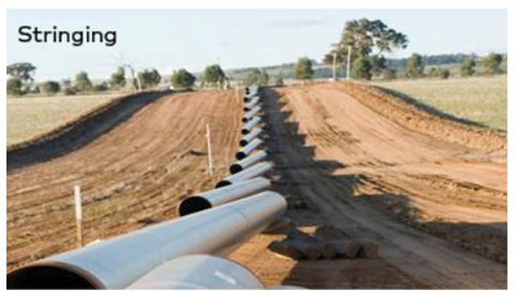
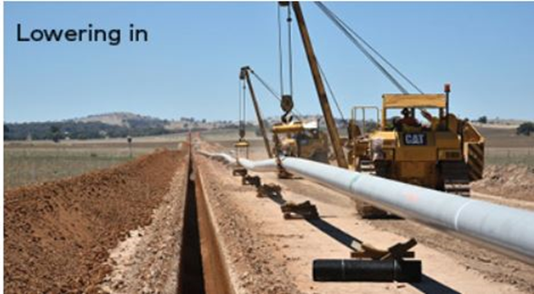
Introduction
Background of the study
The construction of natural gas pipelines is an important step for satisfying these energy demands.
A right-of-way (ROW) location involves a preliminary assessment in which one or multiple corridors are selected. It ensures proper delineation of land parcels for possible routing Aissi 2012
Statement of the problem
Insufficient information on the geological factor's distribution.
Insufficient Right Of Way access due to difficult terrain.
High construction cost due to long distance and abrupt bends.

Slide 4
Introduction
Objectives of the study
To identify all the risks connected to the many criteria used to select the right of way that has the least negative environmental impact
To determine the requirements and defining criteria of the alternative right of way.
To determine site suitability classification and least cost path of the alternative pipeline route.
Research Questions
What is the best alternative route with the least cost?
How relevant and feasible is the initial route when compared with the alternative right of way that was obtained?
Which criteria are used to ensure optimal planning while minimizing costs when routing this pipeline?

Slide 5
Introduction
Significance of the study
To show how stakeholders can improve the choice and design of the ideal pipeline route while increasing constructability and productivity.
To show how crucial it is to gather precise geological factor distributions for pipeline route selection before mainline construction.
A GIS-based least-cost path analysis route selection technique for locating an alternate right of way, with a potential to lower project costs by around 15–30%.

Slide 6
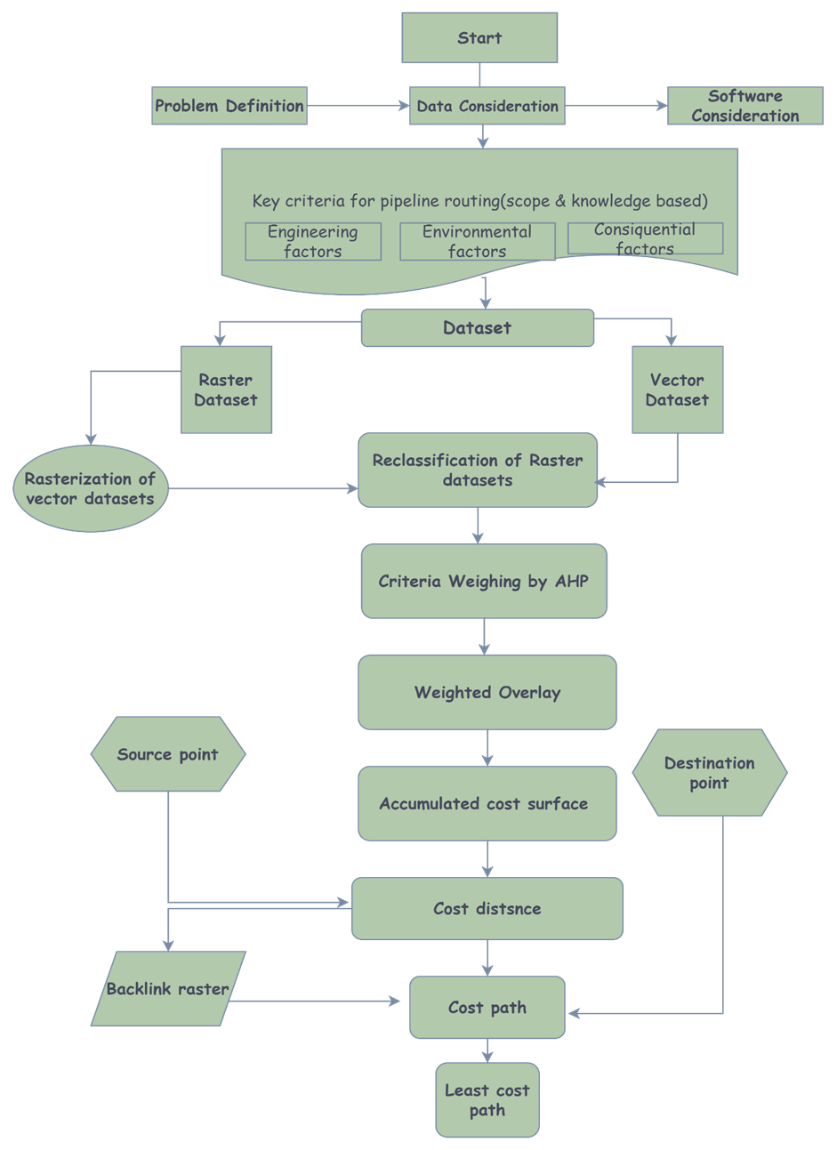
Materials and Methods
Research Framework
Workflow diagram
8

Slide 7
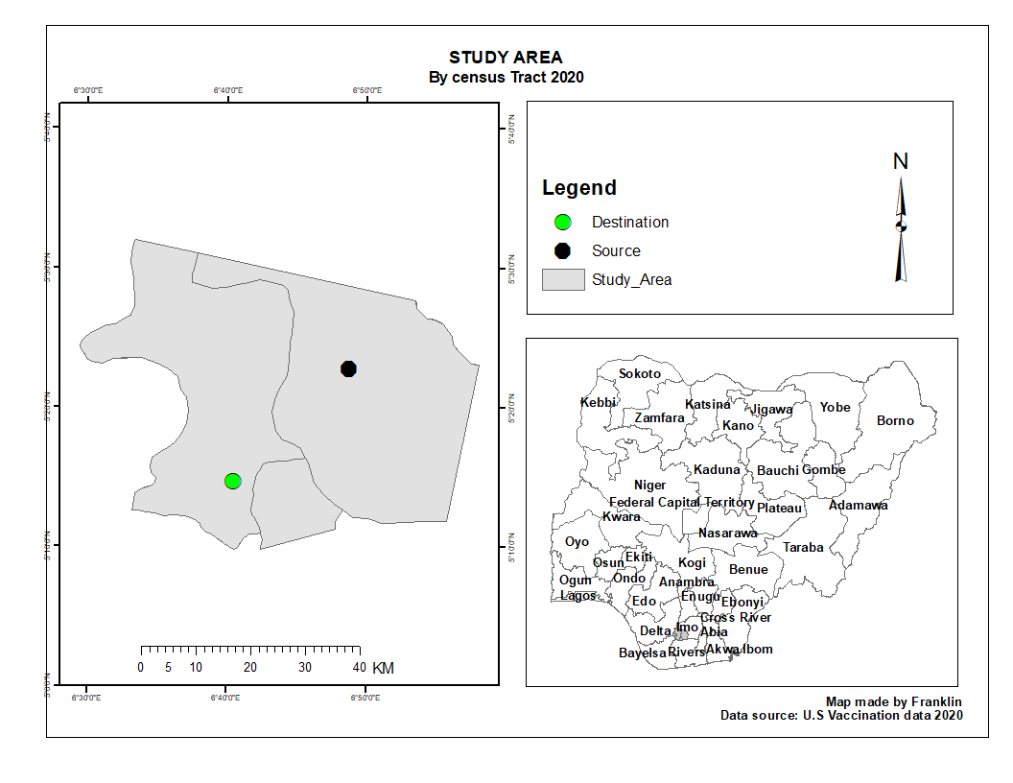
Study Area

Slide 8
Data collection
Data type | Source
Landsat 8 imagery | USGS official website (www.earthexplorer.usgs.gov)
Study area | National Boundary commission (osgof), Abuja
Road and Stream Network Dataset | Office of the surveyor General, (osgof) Abuja (OSGOF, n.d.) 2022
Digital Elevation Model (DEM) | Shuttle Radar Topography Mission USGS official website (www.earthexplorer.usgs.gov)
Geological Map of Nigeria | Nigerian Geological Survey Agency (“Geological Maps,” n.d.) 2022
Criteria data for AHP weighting | Literature review: (Goepel, 2018)
Existing right of way | Geomatics section Shell petroleum development company (SPDC – The Shell Petroleum Development Company of Nigeria | Shell Nigeria, 2021)

Slide 9
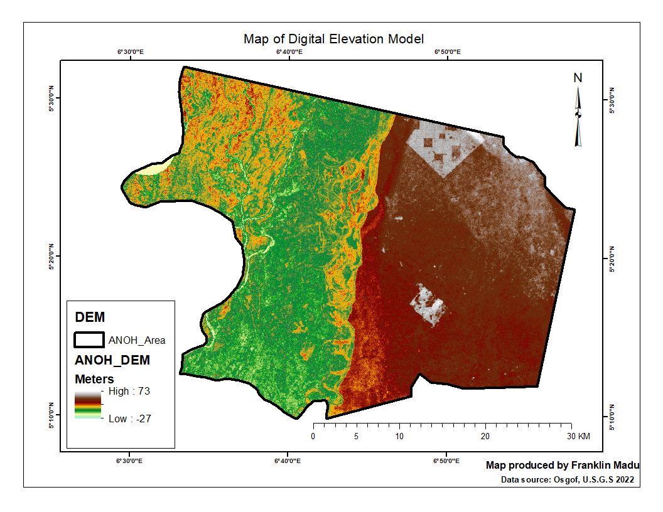
Data analysis
Digital Elevation Model (DEM)

Slide 10
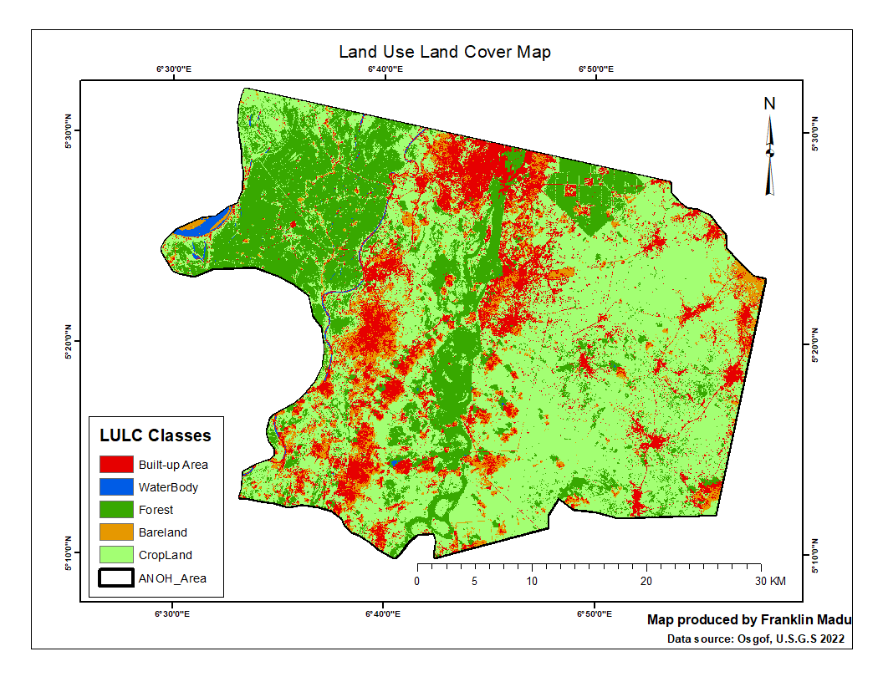
Data Analysis
Land-use of the Study Area

Slide 11
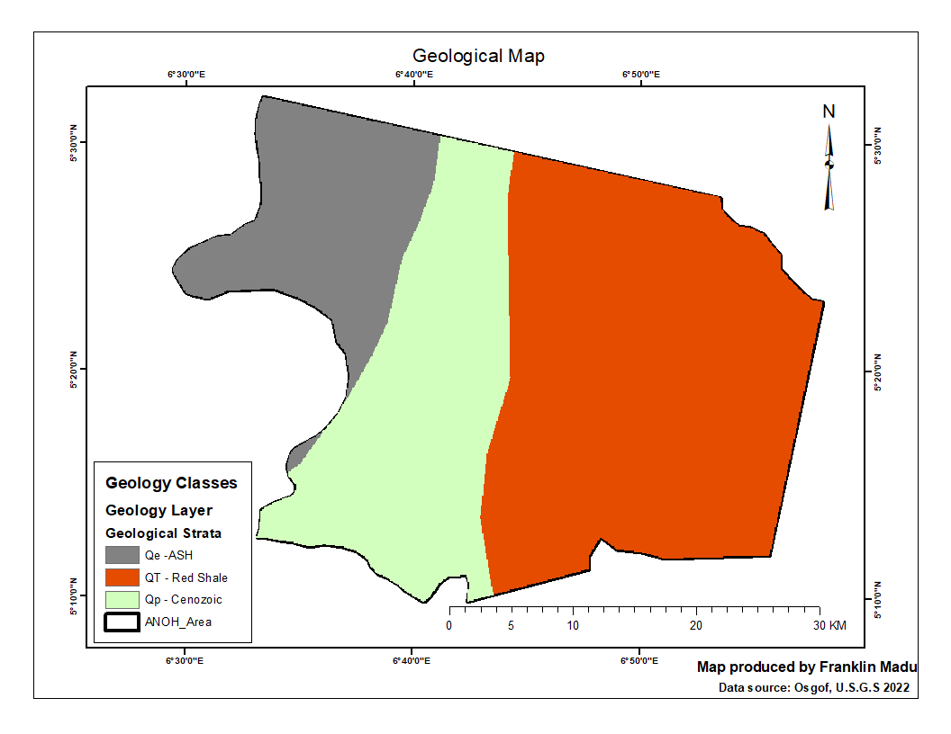
Data Analysis
Geological Map

Slide 12
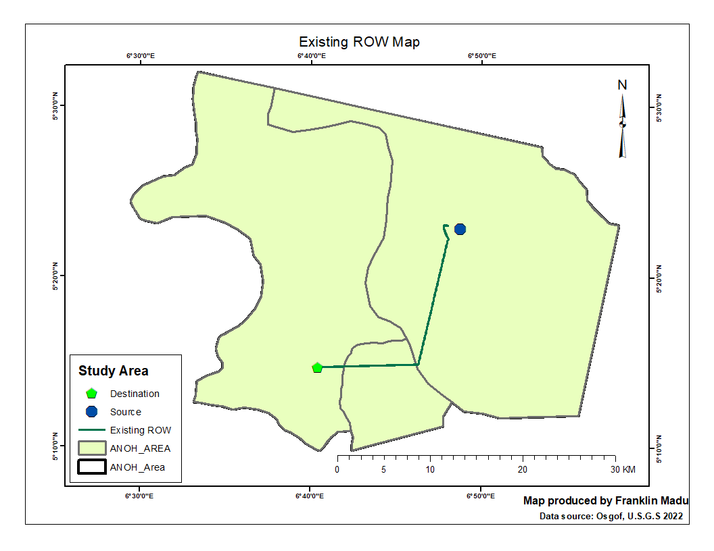
Data Analysis
Existing right of way

Slide 13
Data Analysis
Main criteria for pipeline routing project in Nigeria
S/N | Factor | Sources
1 | Environmental | Balogun (A.-L. Balogun et al., n.d.)
2 | Engineering
3 | Socio-cultural | (A. Balogun, Chandio, et al., 2012)
4 | Manmade | (Chakhar & Martel, 2003; Jafari & Zaredar, 2010)
5 | Natural | (Antoine et al., 1997)
6 | Economical | (Yildirim et al., 2012)
Criteria data for AHP weighting
List of criteria influencing optimal pipeline route selection.
Criteria | Sub-criteria | Sub sub-criteria
Environmental | Land use, Land cover | Forest, builtup, cropland, waterbody, Bareland
Engineering | slope | Steep slope. Gentle slope
Man made | Roads | Double lane, single lane
Natural | Geology | Red shale, ash, cenozoic

Slide 14
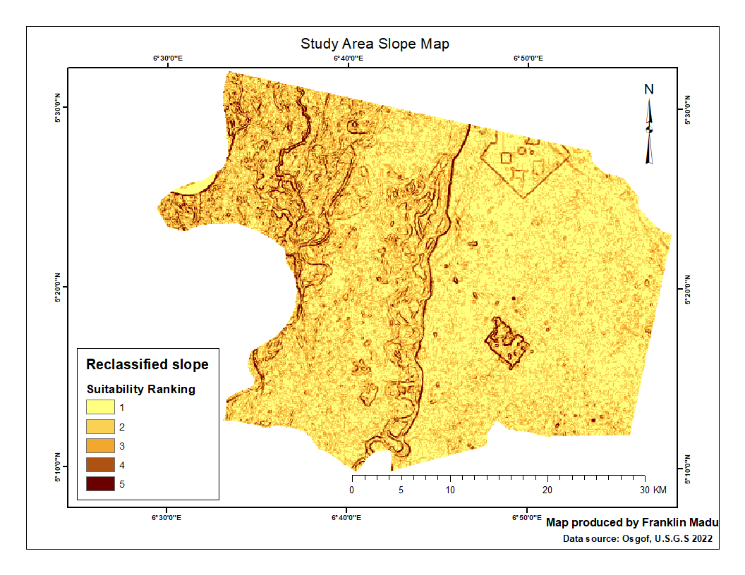
Results and Discussion
Slope Layer
Unified scale for constraints and suitability ranking (modified from (Gilbrook, 1998)).
Ranking | Corridor Constraint | Corridor Suitability
1 | Very Low | Very High
2 | Low | High
3 | Medium | Medium
4 | High | Low
5 | Very High | Very Low

Slide 15
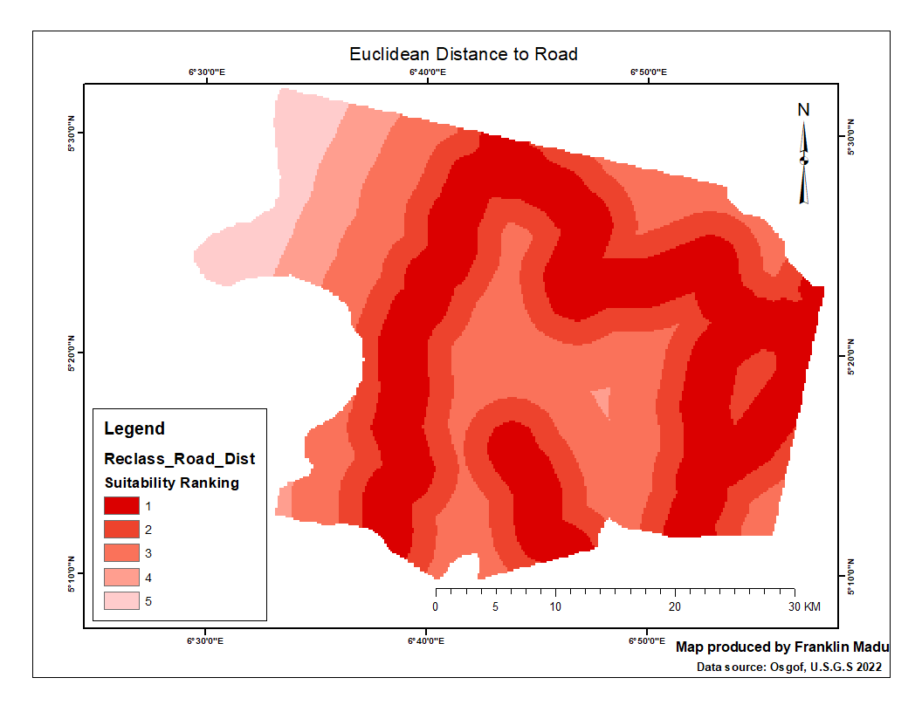
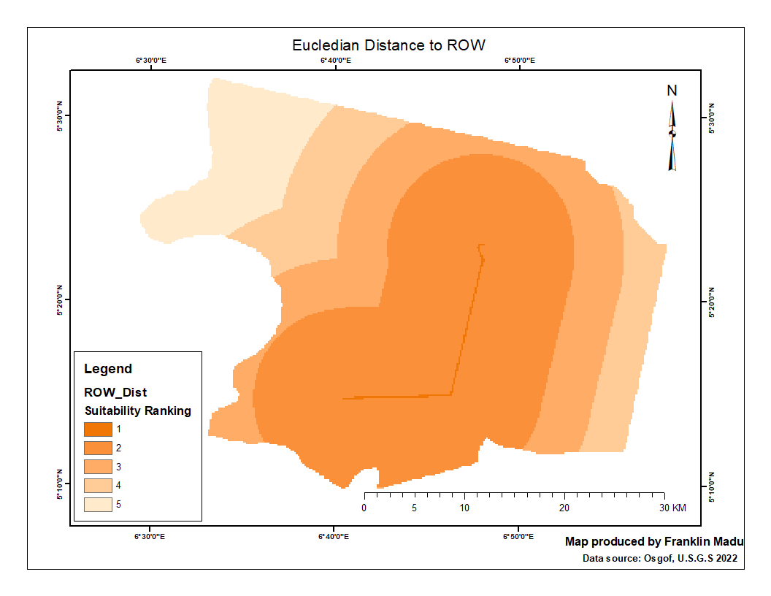
Results and Discussion
Linear Infrastructures (Roads and Existing ROW)

Slide 16
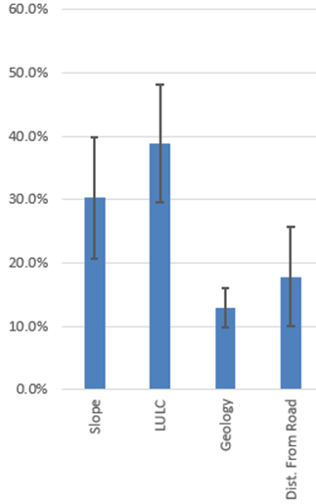
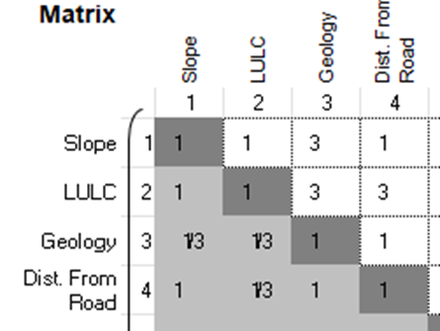
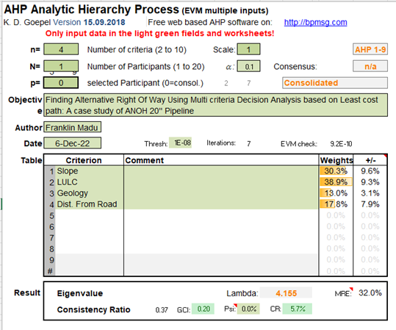
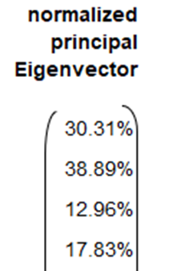
Weights from AHP model
Results and Discussion
Consistency matrix
Criteria Weights
Criteria bar chat
AHP for LCP Model 1

Slide 17
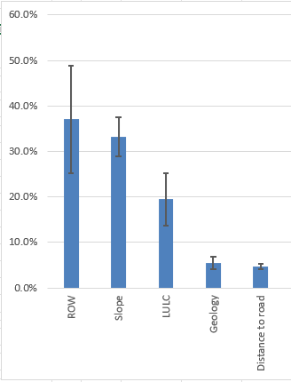
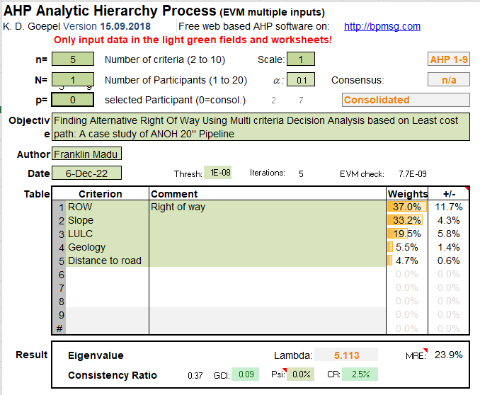
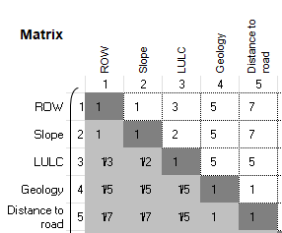
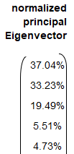
Weights from AHP model
Results and Discussion
Consistency matrix
Criteria Weights
Criteria bar chat
AHP for LCP Model 2

Slide 18
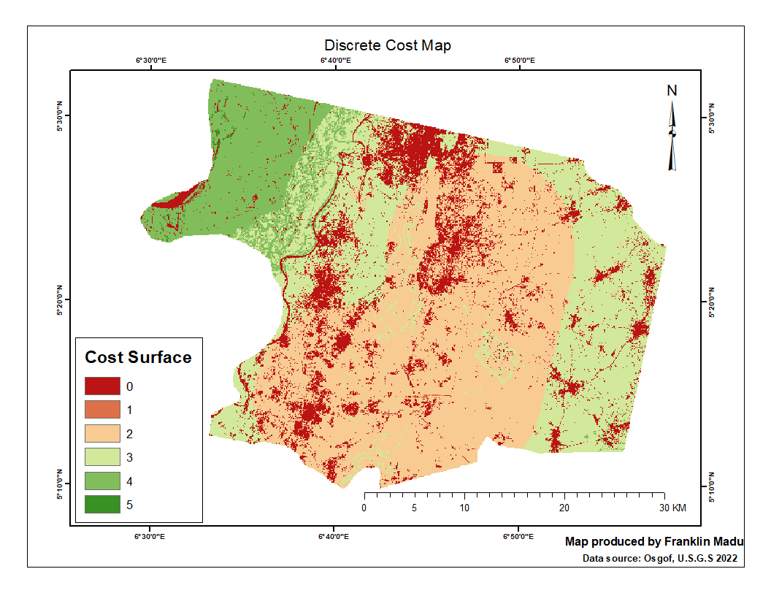
Results and Discussion
Discrete cost map (cost surface)

Slide 19
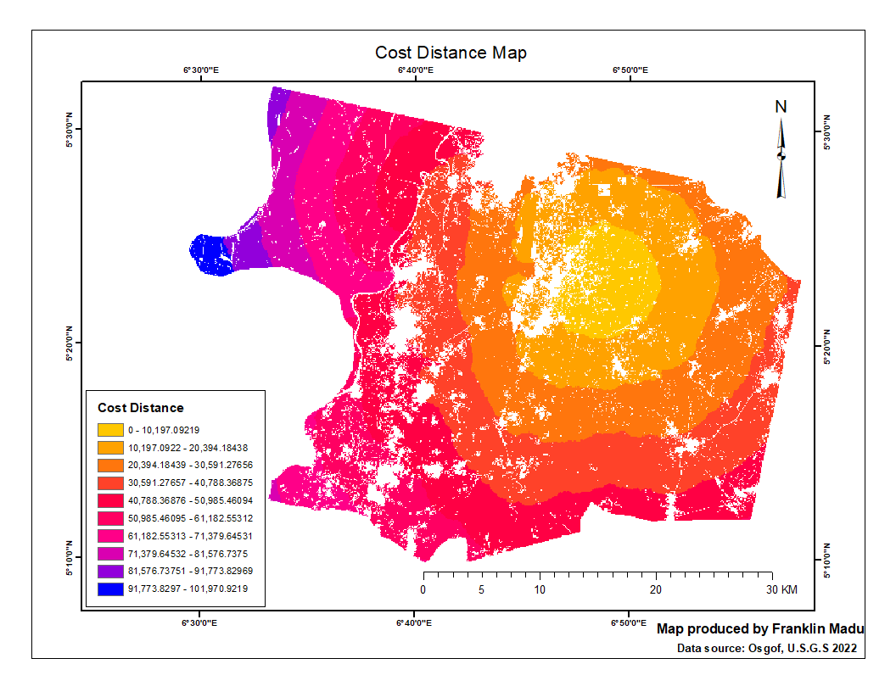
Results and Discussion
Cost Distance Map

Slide 20
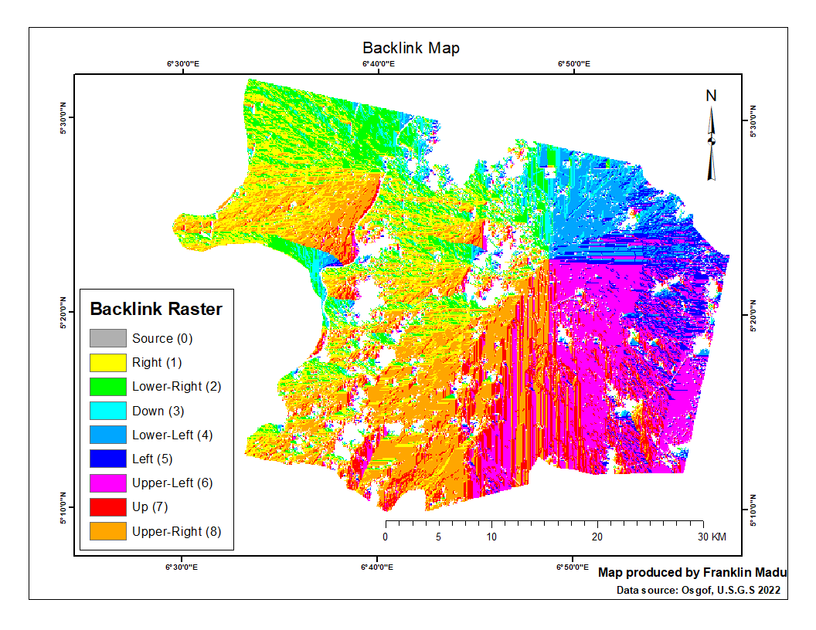
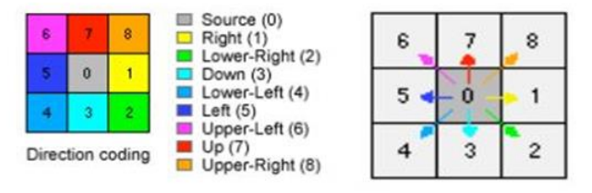
Results and Discussion
Backlink Raster
Backlink Coding

Slide 21

Results and Discussion
Least Cost Path

Slide 22
Results and Discussion
Comparison of the alternative routes
Costs | Existing ROW | Optimal Route 1 | Optimal Route 2
Lengths (km) | 28 | 22.42 | 21.78
No of River crossings | 1 | 0 | 0
No of Road crossings | 7 | 0 | 0
No. of pipeline crossings | 5 | 0 | 0
Least Cost Path
Costs and lengths of the optimal routes.
Optimal Route Alternatives | Accumulated Cost Distance | Pipeline Length (km) | Length Diff. from the existing ROW | Percentage(%) Diff. in Lenght
Optimal Route 1 | 101,970.9219 | 22.42 | 5.58 | 19.92
Optimal Route 2 | 126,432.3828 | 21.78 | 6.22 | 22.21

Slide 23
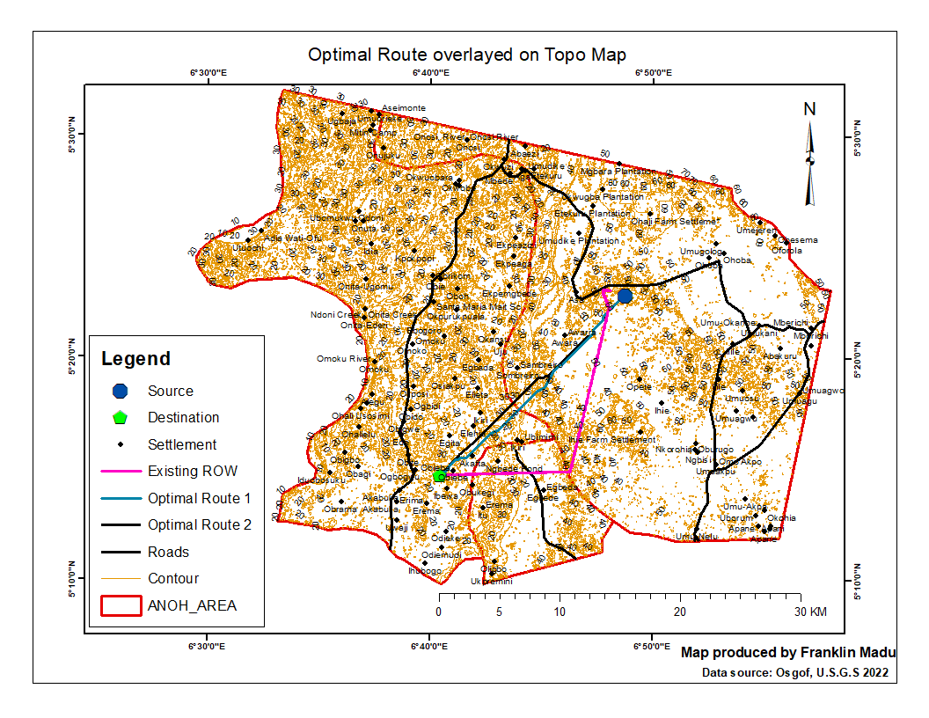
Results Validation
Topo Overlay

Slide 24
Discussion.
MCDA-LCP analysis is powerful because it can store geographical data and analyze it more effectively and conveniently than paper maps (O’Looney, 2000; Wasi & Bender, 2004).
All spatial criteria are combined and analyzed to produce a cost surface for the entire study area.
Based on the two cost surfaces in this study, the least-cost routing tool performs better than the existing ROW.
The optimal route crosses fewer steep areas, water resources and other significant features, making them more cost-effective, and they have a shorter length than existing routes.
These are the top priorities during route design. In agreement with previous studies (A. Balogun, Chandio, et al., 2012; A. Balogun, Matori, et al., 2012; A.-L. Balogun et al., n.d.; Volkan Yildirim & Sevket Bediroglu, n.d.; Yildirim et al., 2012; Yildirim & Bediroglu, 2019, 2019),
An integration approaches (RS & GIS) can facilitate a better understanding of the pipeline routing procedure as confirmed by (Volkan Yildirim & Sevket Bediroglu, n.d.; Yildirim et al., 2012; Yildirim, Yomralioglu, Nisanci, Çolak, et al., 2017)

Slide 25
Conclusion
Summary
Recommendations
This study aimed to determine the optimal pipeline route using MCDA LCPA.
To determine the optimal path for the pipeline, Arc GIS and MCDA-LCP were used.
Using AHP toolbox, selecting the optimal path for a weighted overlay suitability map is possible by using criteria such as LULC.
Using the ArcGIS weighted overlay tool, the discrete Cost Map was derived from the weighted overlay of these criteria (layers).
Optimal routes indicate the path that will result in the least cost for the pipeline project.
There is a possibility of linking the output of this methodology with linear infrastructure design software.
All route selection tasks should be conducted using this method as a preliminary investigation.
For more accurate results, use recent images and current datasets with high resolution.
Involvement of expert opinion in the process of selecting the necessary criteria and determining their appropriate weights and influences.

Slide 26
Conclusion
This thesis presents a GIS-based multicriteria evaluation approach for determining the optimal paths for constructing a linear facility.
Certain pitfalls were avoided during criteria selection, thus fulfilling the objective of this study within the given criteria.
When compared to the existing ROW, the least-cost paths indicate the most efficient routes that provide a path between the documented sources and destinations.
Strengths and limitations
This methodology has the advantage of being applicable to routing applications of all types.
This methodology has the capability of allowing different groups or experts to evaluate criteria and produce routes.
This methodology relies heavily on spatial data.
There are two primary issues and they related to data availability and scale.

Slide 27
Reference
Saaty, T. L. (1980). The Analytic Hierarchy Process Mcgraw Hill, New York. Agricultural Economics Review, 70.
Sadek, S., Bedran, M., & Kaysi, I. (1999). GIS Platform for Multicriteria Evaluation of Route Alignments. Journal of Transportation Engineering, 125(2), 144–151. https://doi.org/10.1061/(ASCE)0733-947X(1999)125:2(144)
Seel, K., Dragan, M., Coulombe-Pontbriand, M., Laird, C. S., & Campbell, C. (2014). A Spatial Multi-Criteria Analysis Process to Optimize and Better Defend the Pipeline Route Selection Process. Volume 1: Design and Construction; Environment; Pipeline Automation and Measurement, V001T04A004. https://doi.org/10.1115/IPC2014-33221
Singh, M. P., & Singh, P. (2017). Multi-criteria GIS modeling for optimum route alignment planning in outer region of Allahabad City, India. Arabian Journal of Geosciences, 10(13), 294. https://doi.org/10.1007/s12517-017-3076-z
Stucky, J. L. D. (1998). On applying viewshed analysis for determining least-cost paths on Digital Elevation Models. International Journal of Geographical Information Science, 12(8), 891–905. https://doi.org/10.1080/136588198241554
Warntz, W. (1957). Transportation, Social Physics, And The Law Of Refraction. The Professional Geographer, 9(4), 2–7. https://doi.org/10.1111/j.0033-0124.1957.094_2.x
Wasi, S. R., & Bender, J. D. (2004). Spatially Enabled Pipeline Route Optimization Model. 2004 International Pipeline Conference, Volumes 1, 2, and 3, 699–707. https://doi.org/10.1115/IPC2004-0362
Yakar, F., & Celik, F. (2014). A highway alignment determination model incorporating GIS and multi-criteria decision making. KSCE Journal of Civil Engineering, 18(6), 1847–1857.

Slide 28

Thank you
Questions?....

Slide 29
Literature Review
A GIS-based approach
Multi-Criteria Decision Analysis
The choice of a prospective ROW necessitates a complex process of examination of a vast array of criteria (Sadek et al., 1999).
The engineering and environmental design requirements largely determine the design and operation of a pipeline route.
The oil and gas industry is increasingly relying on GIS technology to support decision-makers in choosing an ideal path when laying up new pipelines.
This lessens the negative effects of development on the environment and lowers operational and construction expenses (A. Balogun, Matori, et al., 2012).
MCDM is frequently used to analyze complex information and choose between several alternatives and has shown to be a promising and expanding topic of study (Yakar & Celik, 2014).
The conventional approach is ineffective because it ignores important aspects that could alter the pipeline's route, (Isa Adekunle Hamid-Mosaku et al., n.d.; Wasi & Bender, 2004).
GIS and MCDA analyses the geographical correlation between several layers of spatial data (Gyabeng, 2020).
For the decision-maker, it offer a mechanism to pick and assess numerous alternative solutions (Jankowski, 1995; Malczewski, 2010)
Least Cost Path (LCP)
One of the essential components found in most least-cost routing models is the Edsger Dijkstra algorithm (Dijkstra, 1959).
This kind of analysis concentrates on the vicinity of cells around the suggested starting point and expands outward to eventually cover the full study area (Collischonn & Pilar, 2000)
This routing procedure applies various weighting scenarios and opinions while combining components to build adequate cost surfaces (Abudu & Williams, 2015; Atkinson et al., 2005).

Slide 30
Review of previous studies
Kelly (2014),
Durmaz (2019)
Bagli (2011)
The project is a case study for a least-cost route analysis using a GIS on a segment of the proposed pipeline in Western Turkey.
To determine the LCP through the study area by weighing several criteria in a risk assessment map.
By including both physical and environmental risk factors, the study offered a fresh new case study that will promote GIS
The subject of this study is the automatic natural gas pipeline design.
The optimal route for a natural gas pipeline was found utilizing GIS and a least-cost path algorithm
The high vertex points were removed using a point removal technique and a cartographic line simplification process.
A 20% cost reduction through simplicity was achieved using GIS capabilities and the LCP distance method.
Provides a method for power-line routing based on LCPA and MCE of suggested pathways.
Human health, geography, and habitat fragmentation were all considered
Considered biological effects while deciding how to route a facility and incorporated those factors into the model.

Slide 31
The Analytical Hierarchy Process (AHP)
Steps of Analytical Hierarchy Process (AHP)
Develop a hierarchical structure with a goal at the top level, the attribute/criteria at the second level and the alternatives at the third level.
Determine the relative importance of different attributes or criteria with respect to the goal.
Pair-wise comparison of each criterion's alternatives depending on how well they performed against each criterion.
From a matrix of outcomes from pairwise comparisons, compute the vector of criteria weights.
Create a matrix showing the normalized performance of each option using the results of the pairwise comparisons.
Use the vectors of criteria weights and the matrix of alternative scores to rank the alternatives.

Slide 32
The Analytical Hierarchy Process (AHP)
Pair wise Comparisons in AHP
Pairwise comparison in AHP refers to the process of contrasting two entities side by side to determine which is preferred and by how much
Scale | Relative Importance
1 | Equal importance.
3 | Moderate importance
5 | Strong importance.
7 | Very strong importance.
9 | Extreme importance.
2,4,6,8 | Intermediate values
1/3, 1/5, 1/7, 1/9 | Values for inverse comparison.

